Slide 1
S K Y Z O D I A C
T H E W E A T H E R F O R E C A S T W E B S I T E

Slide 2
T E A M M E M B E R S
M O H A N R A M J S A R A V I N D K U M A R V
1 9 P W 1 5 1 9 P W 0 2

Slide 3
A B S T R A C T
The ultimate aim was to create a visually appealing at the same time simple looking weather forecasting website.
We use 2 APIs in this website in order to get the necessary information.
We use html , css , java script , node.js widely.
The website will allow you to enter the location of which you want to get the weather report . You can either enter the location name or you can enter the coordinates of the location .
Then you will get the weather report of the present day ( temperature, pressure, wind speed , maximum temperature , minimum temperature, visibility) .
Then you will also receive the forecast of the next 4 days also.

Slide 4
T E C H U S E D
Html 5
Css 3
Javascript 1.8.5
Node.js 12.18.0

Slide 5
T O O L S U S E D
SUBLIME TEXT EDITOR
VISUAL STUDIO CODE
NETLIFY
PHOTOSHOP
GIT HUB

Slide 6
A R C H I T E C T U R A L D I A G R A M
SKY ZODIAC
INPUT
MAPBOX API
LOCATION
COORDINATE
GEOCODING
INPUT WITH INFORMATION
OPENWEATHERMAP API
WEATHER INFORMATION IN JSON FORMAT
WEATHER INFO
[ RESULT ]
PROCESSING

Slide 7
f u n c t i o n a l s p e c i f i c a t i o n

Slide 8
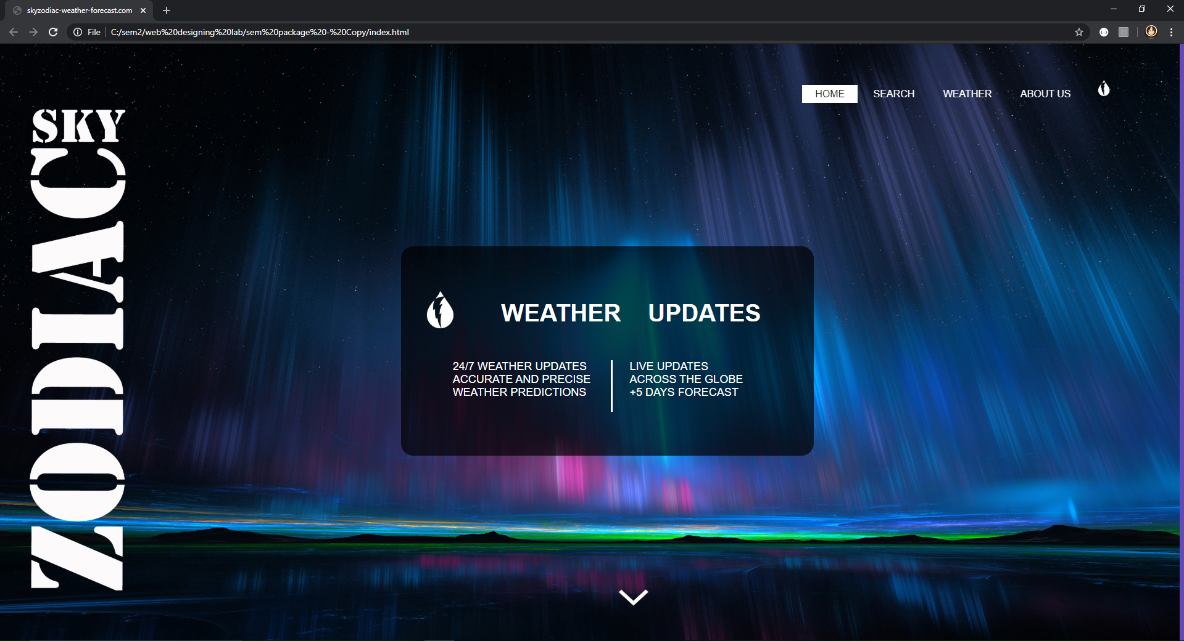

Slide 9
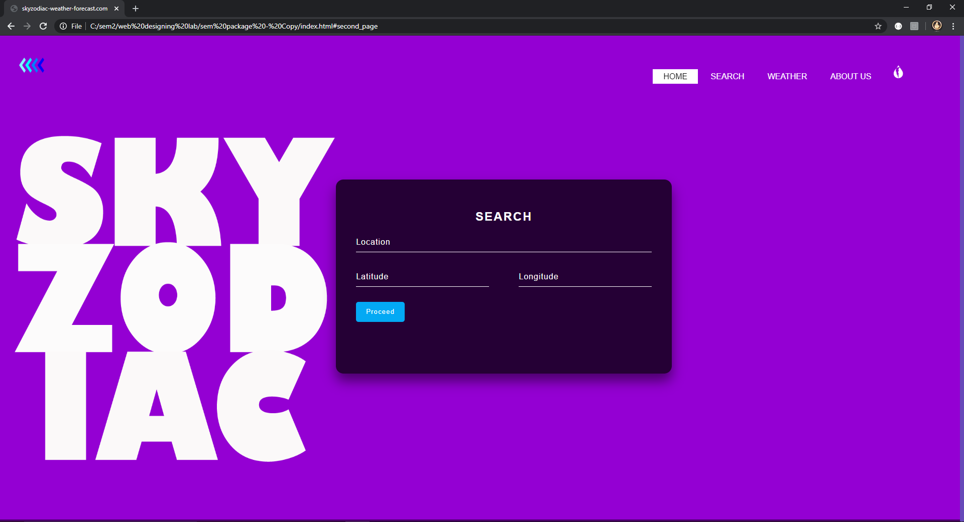

Slide 10


Slide 11
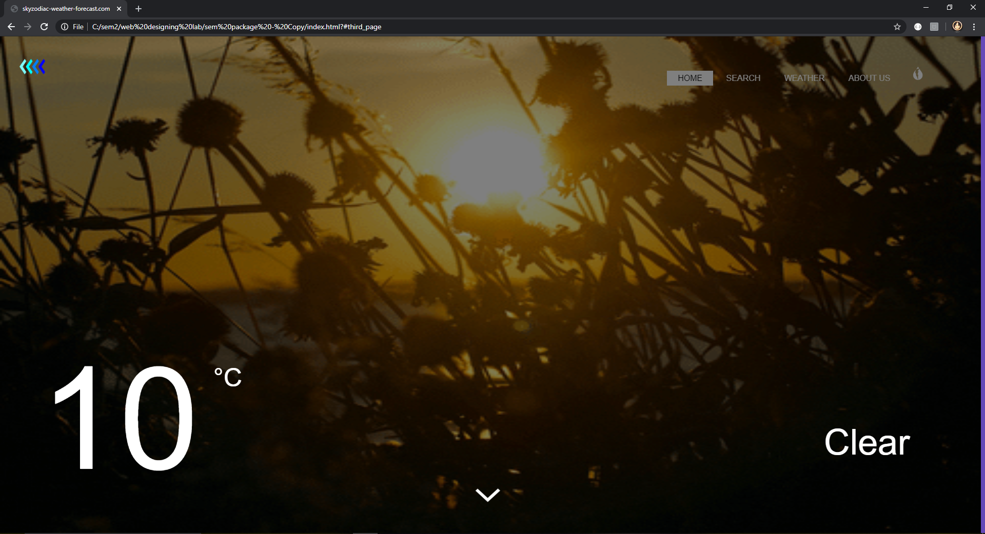

Slide 12
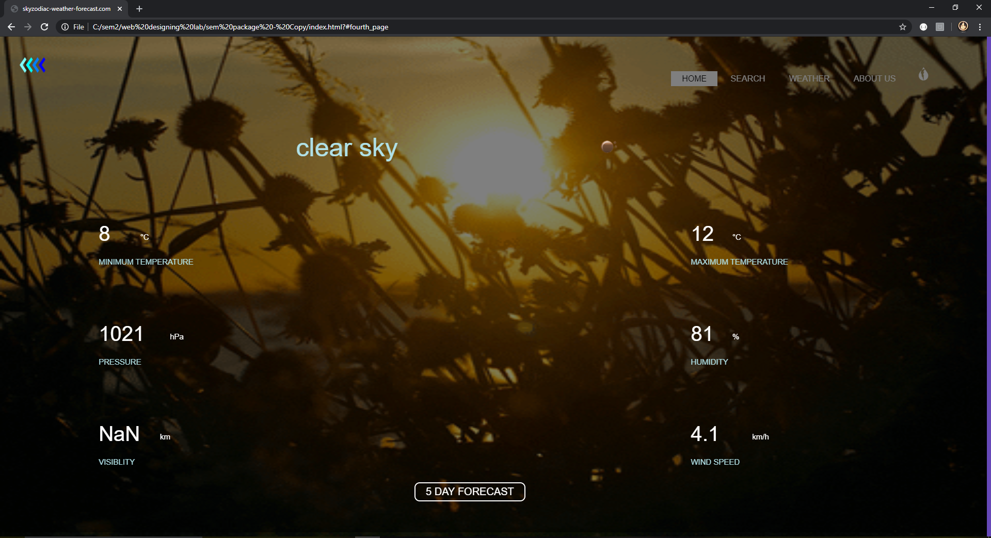

Slide 13
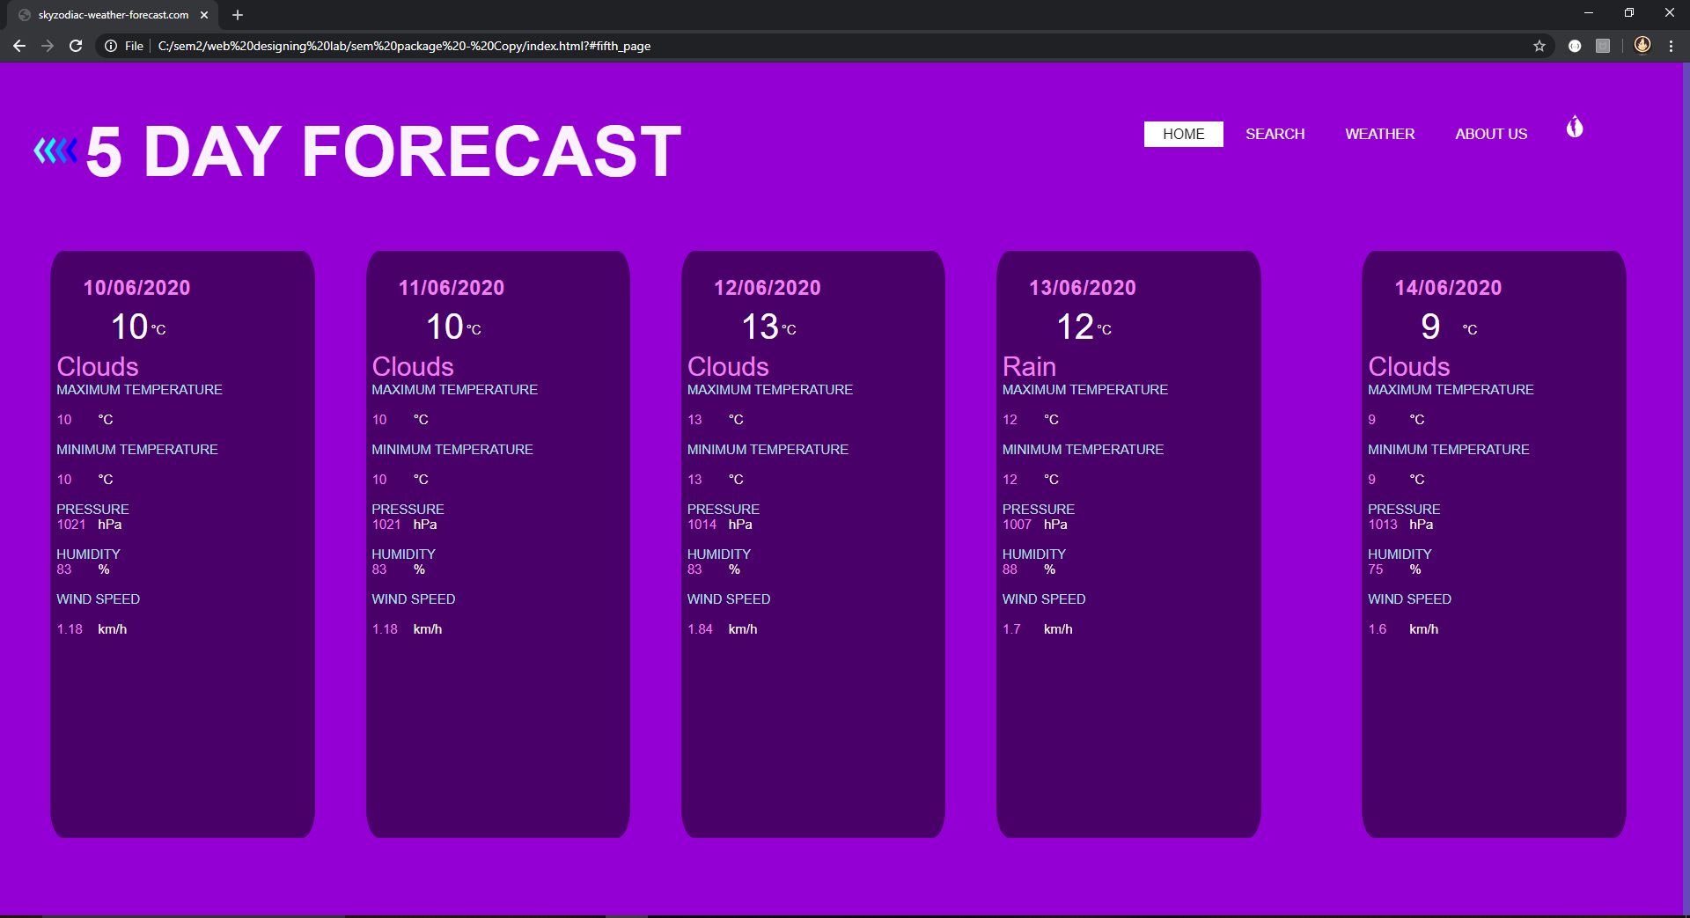

Slide 14
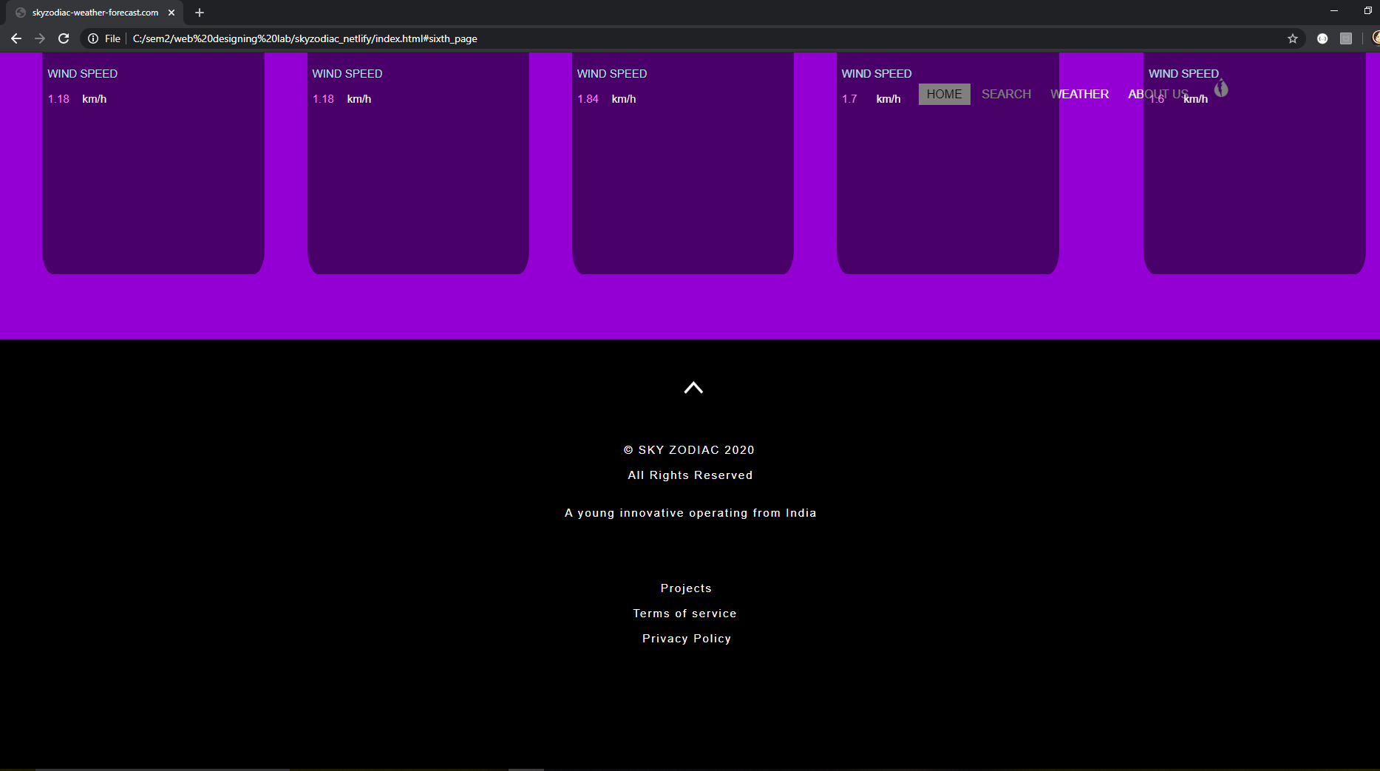

Slide 15
autofill1() - When the location is entered this function takes it to the mapbox api and finds and fills the coordinates of the place entered
autofill2() - When the coordinates are entered this function takes it to the mapbox api and finds and fills the location of the coordinates
mainfunction() - This is the function that call the openweathermap api and gets the weather report of the location in jason format
change_background() - This is the function that is responsible for changing the gif of the background according to the weather description
change_background2() - This is the same as the first function but changes it for a different function
forecast() - This is the function that calls the openweathermap api again to get the 5 days forecast

Slide 16
C O N C L U S I O N
In making this package we learnt to work with api and node.js
The most difficulties were faced when aligning the div tabs.
Also making the website visually appealing was a difficult as the alignment was different on different devices.
It was fun experimenting with the css tools in order to make the website beautiful as well as to keep it simple.

Slide 17
R E F E R E N C E S
w3schools.com
Materials provided
Freecodecamp.org
stackoverflow.com

Slide 18
T H A N K Y O U

